Slide 1
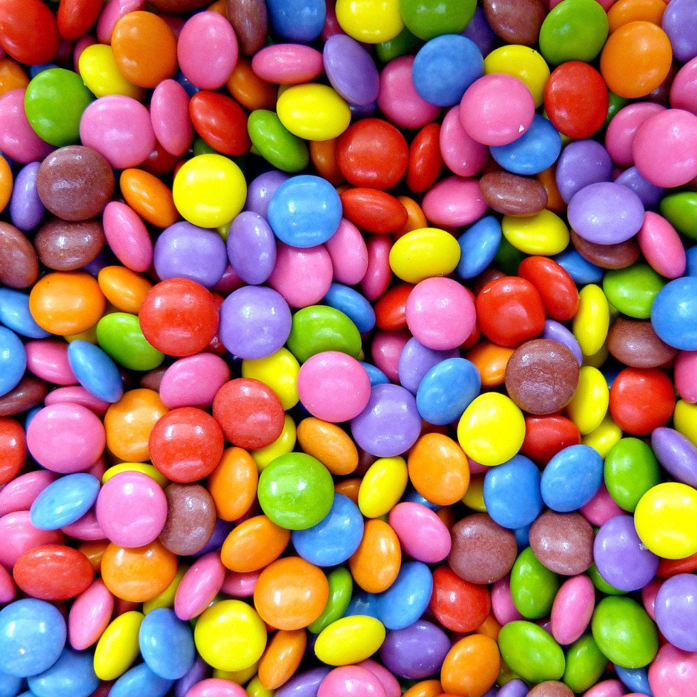
The Friends of St. Peter’s ‘Silver Smarties’ Challenge

Slide 2
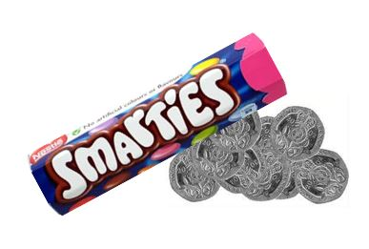
Did you know?
There are about 48 smarties in each tube!
Smarties have been sold since 1937 (82 years)
They come in 8 colours: red, orange, yellow, green, blue, mauve, pink and brown
You can fit £12 worth of 20ps in one smarties tube
You can fit £27 worth of £1 coins in each smarties tube

Slide 3
Your Challenge
You will each take home a tube of Smarties today to say ‘well done’ for all your hard work at school.
Then using the empty tube, you need to do lots of little jobs around the house over half term to earn 20 pence pieces.
The more jobs you do, the more 20p pieces you can collect to put back in your tube.
You have two weeks to collect as many as you can!
Bring in your tube, sealed with your name on and full of 20p coins, on Friday 7th June for an exciting week of Smarties activities in school.

Slide 4
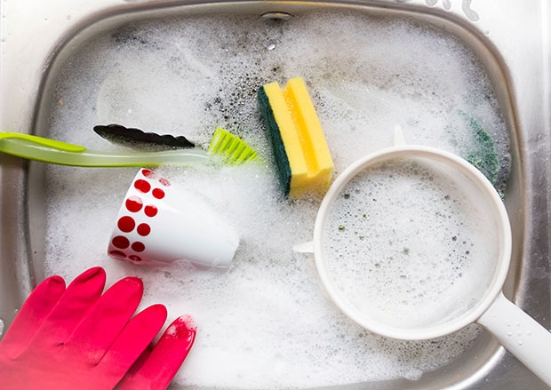
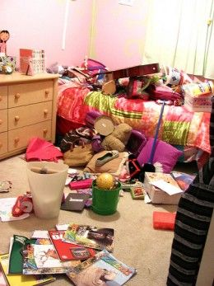
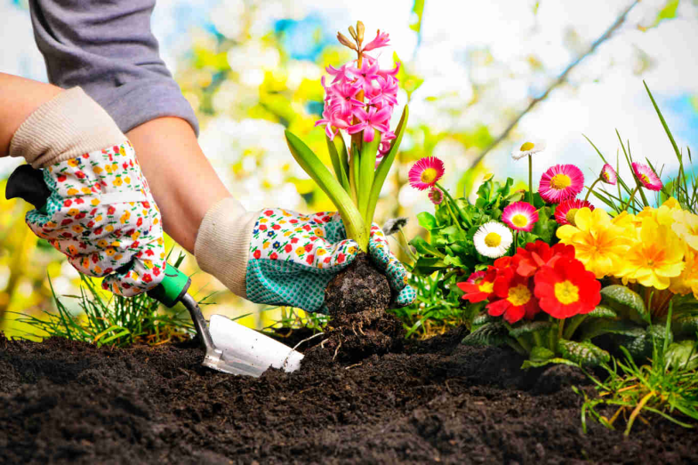
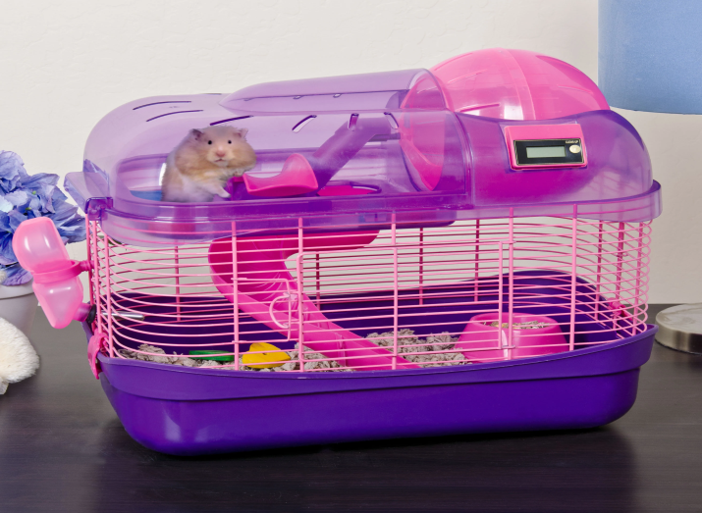
What can you do to earn 20p?

Slide 5
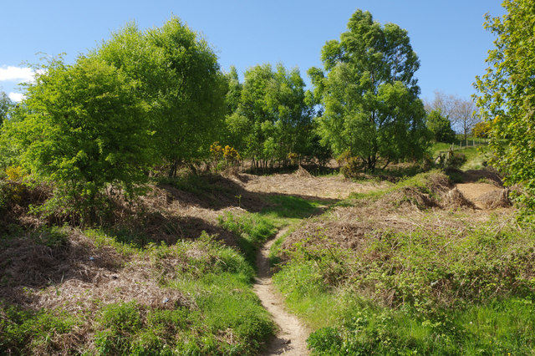
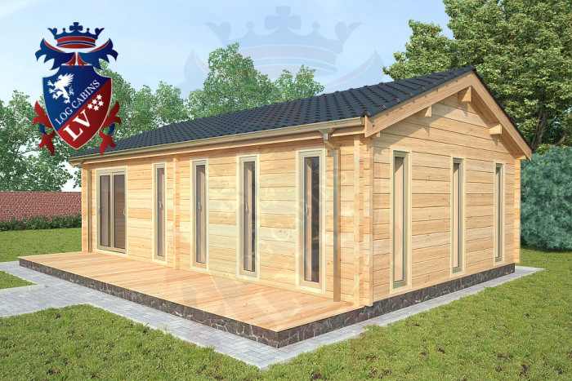
What are we raising money for?
With all the money you raise, we are hoping that Friends of St. Peter’s can build us our very own outdoor classroom to do learning outside, have more Forest Schools activities and use the Hednesford Hills more often for our lessons.

Slide 6
Silver Smarties week
When you bring your tubes back to school, we will be having a Silver Smarties week. Your teachers are busy planning exciting lessons and events to use Smarties and 20p pieces to give us an exciting week of learning including:
Lots of art and creative activities
A school mystery to solve
Making a huge bar chart of 20ps in the hall
DT, Science and much more

Slide 7
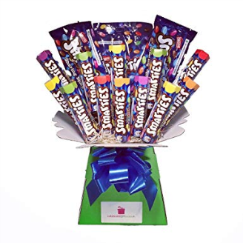
And…
There will be a prize for:
The class that raises the most money in the Silver Smarties challenge
The person who raises the most money by completing the most jobs in two weeks.

